Slide 1

Special machines
Walchand College of Engineering, Sangli.

Slide 2
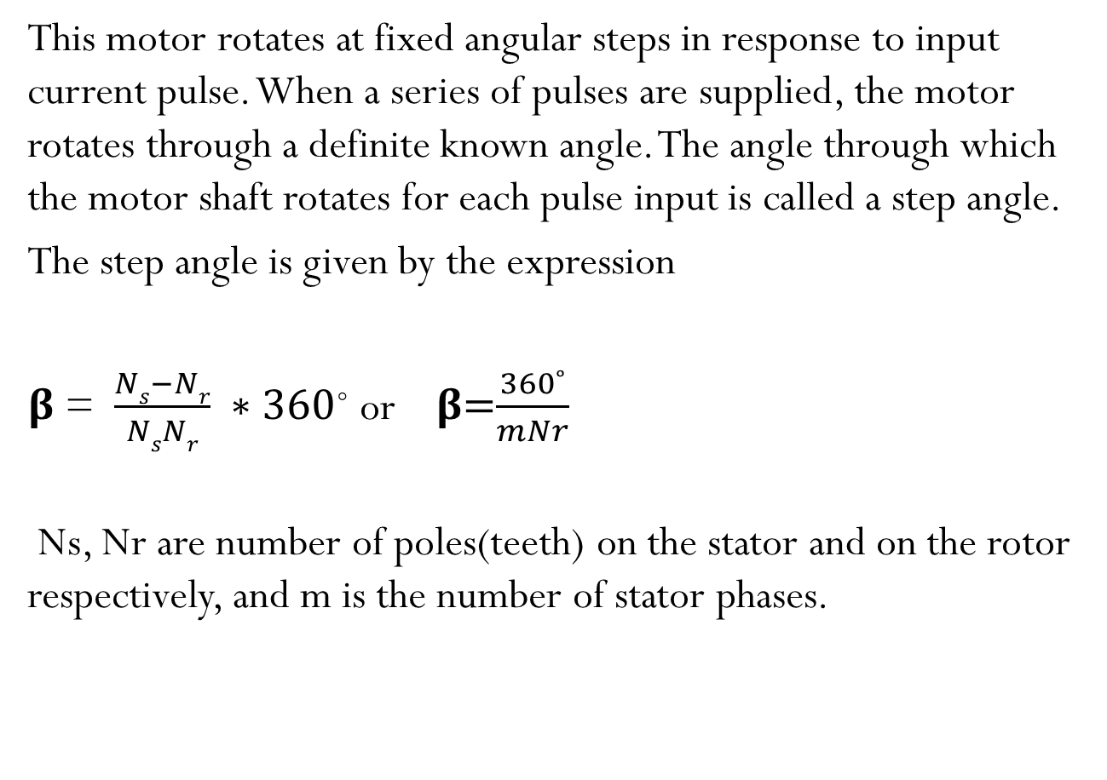
Stepper motor
This motor rotates at fixed angular steps in response to input current pulse. When a series of pulses are supplied, the motor rotates through a definite known angle. The angle through which the motor shaft rotates for each pulse input is called a step angle.
The step angle is given by the expression
𝛃 = $\frac{Ns−Nr}{NsNr} ∗360$˚ or 𝛃=$\frac{360˚}{mNr}$
Ns, Nr are number of poles(teeth) on the stator and on the rotor respectively, and m is the number of stator phases.

Slide 3
Classification of Stepper Motor
Stepper motors are classified as follows:
i) Variable reluctance stepper motor
ii) Permanent magnet stepper motor
iii) Hybrid stepper motor

Slide 4
Variable Reluctance Stepper Motor
The stator have an even number of poles and the windings of opposite poles are connected in series to form one phase.
Rotor is made up of laminated silicon steel or solid silicon steel.
The number of poles on stator differs to that of rotor poles, which provides the ability to self start and bidirectional rotation of the motor

Slide 5
In all these motors excitation windings are employed in stator where the number of windings refer to the number of phases.
A DC voltage is applied as an excitation to the coils of windings and each winding terminal is connected to the source through a solid state switch
Whenever power is applied to the motor and by exciting a particular winding, it produces its magnetic field and develops its own magnetic poles
Diametrically opposite pairs of stator coils are connected in series such that when one tooth becomes a N-pole, the other one becomes a S-pole.

Slide 6
Working Variable Reluctance Stepper Motor
When there is no current in the stator coils, the rotor is completely free to rotate. Energizing one or more stator coils causes the rotor to step forward (or backward) to a position that forms a path of least reluctance with the magnetized stator teeth.
The step angle of this 3-phase 4-pole rotor teeth stepper motor is expressed as, 360/ (4 × 3) = 30 degrees

Slide 7
a) 1-phase-ON or Full-step Operation
Consider the schematic diagram of a 3-phase, 6 stator poles and 4 rotor teeth is shown in figure below. When the phase A-A’ is supplied with a DC supply by closing the switch -1, the winding become a magnet which results one tooth become North and other South. So the stator magnetic axis lies along these poles.
Due to the force of attraction, stator coil North Pole attracts nearest rotor tooth of opposite polarity, i.e., South and South Pole attract nearest rotor tooth of opposite polarity, i.e., North. The rotor then adjusts to its minimum reluctance position where the rotor magnetic axis exactly matches with stator magnetic axis.

Slide 8
When the phase B-B’ is energized by closing switch -2 keeping phase A-A’ remain de-energized by opening switch-1, winding B-B’ will produce the magnetic flux and hence the stator magnetic axis shifts along the poles thus formed by it. Hence the rotor shifts to the least reluctance with magnetized stator teeth and rotates through an angle of 30 degrees in the clockwise direction.
When the switch-3 is energized after opening switch-2, the phase C-C’ is energized, the rotor teeth align with new position by moving through an additional angle of 30 degrees.

Slide 9
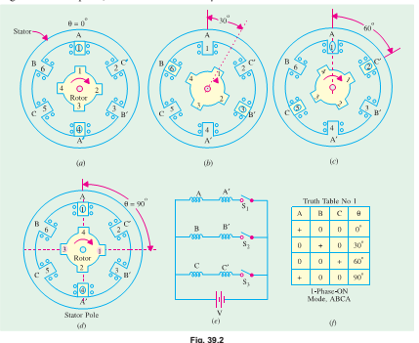

Slide 10
b) 2-phase-ON Mode
In this mode of operation, two stator phases are excited simultaneously. When phases A and B are energized together, the rotor experiences torques from both phases and comes to rest at a point mid-way between the two adjacent full-step positions.
If the stator phases are switched in the sequence AB, BC, CA, AB etc., the motor will take full steps of 30º each (as in the 1-phase-ON mode) but its equilibrium positions will be interleaved between the full-step positions

Slide 11
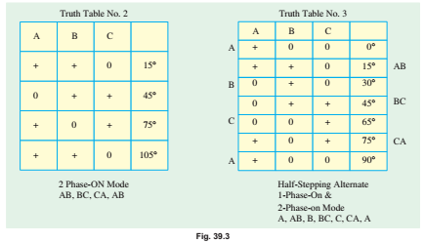

Slide 12
c) Half-step Operation
Half-step operation or ‘half-stepping’ can be obtained by exciting the three phases in the sequence A, AB, B, BC, C etc. i.e. alternately in the 1-phase-ON and 2-phase-ON modes. It is sometime known as ‘wave’ excitation and it causes the rotor to advance in steps of 15º i.e. half the full-step angle. The truth table for the phase pulsing sequence in half-stepping is shown in Fig.
Half-stepping can be illustrated with the help of Fig. where only three successive pulses have been considered. Energizing only phase A causes the rotor position shown in Fig(a). Energising phases A and B simultaneously moves the rotor to the position shown in Fig(b) where rotor has moved through half a step only. Energising only phase B moves the rotor through another half-step as shown in Fig (c). With each pulse, the rotor moves 30 / 2 = 15º in the CCW direction

Slide 13
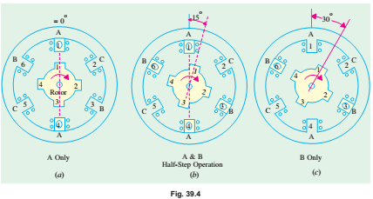

Slide 14
d)Micro-stepping
It is also known as mini-stepping. It utilizes two phases simultaneously as in 2-phase-ON mode but with the two currents deliberately made unequal (unlike in half-stepping where the two phase currents have to be kept equal). The current in phase A is held constant while that in phase B is increased in very small increments until maximum current is reached. The current in phase A is then reduced to zero using the same very small increments. In this way, the resultant step becomes very small and is called a microstep.
Stepper motors employing microstepping technique are used in printing and phototypesetting where very fine resolution is called for. As seen, microstepping provides smooth low-speed operation and high resolution

Slide 15
Application
Due to the precise control of speed, rotation, direction, and angular position, these are of particular interest in industrial process control systems, CNC machines, robotics, manufacturing automation systems, instrumentation, antennas, telescopes, and some toys.

Slide 16
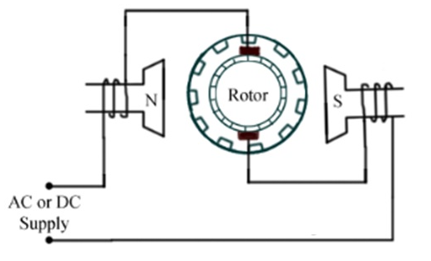
Universal motor
It is a single-phase motor which can run on either DC or single-phase AC supply.
The armature and field winding of this motor are connected in series and hence, it has a high starting torque.

Slide 17
Construction of Universal motor
The armature of the universal motor is similar to that of a small DC motor with laminated core having either straight slots or skewed slots and a commutator to which the leads of the armature winding are connected. Both the core and commutator are pressed on the shaft.

Slide 18
Working of Universal motor
When the universal motor is fed with DC supply, it works as a DC series motor.
When fed with AC supply, it still produces unidirectional torque. Since armature winding and field winding are connected in series, they are in same phase.

Slide 19
Applications Of Universal Motor
Universal motors find their use in various home appliances like vacuum cleaners, drink and food mixers, domestic sewing machine etc.
The higher rating universal motors are used in portable drills, blenders etc.

Slide 20
Servomechanism
A servo system mainly consists of three basic components - a controlled device, a output sensor, a feedback system.
This is an automatic closed loop control system. Here instead of controlling a device by applying variable input signal, the device is controlled by a feedback signal generated by comparing output signal and reference input signal.
When reference input signal or command signal is applied to the system, it is compared with output reference signal of the system produced by output sensor, and a third signal produced by feedback system. This third signal acts as input signal of controlled device. This input signal to the device presents as long as there is a logical difference between reference input signal and output signal of the system.

Slide 21
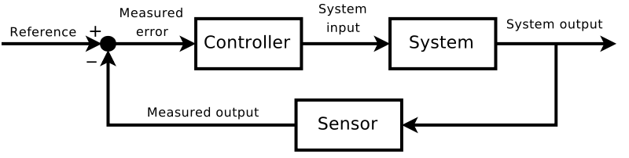
After the device achieves its desired output, there will be no longer logical difference between reference input signal and reference output signal of the system. Then, third signal produced by comparing theses above said signals will not remain enough to operate the device further and to produce further output of the system until the next reference input signal or command signal is applied to the system. Hence the primary task of a servomechanism is to maintain the output of a system at the desired value in the presence of disturbances.

Slide 22
Servo motor
A servomotor is a rotary actuator that allows for precise control of angular position, velocity and acceleration. It consists of a suitable motor coupled to a sensor for position feedback. It also requires a relatively sophisticated controller, often a dedicated module designed specifically for use with servomotors.
Servomotors are used in applications such as robotics, CNC machinery or automated manufacturing.

Slide 23
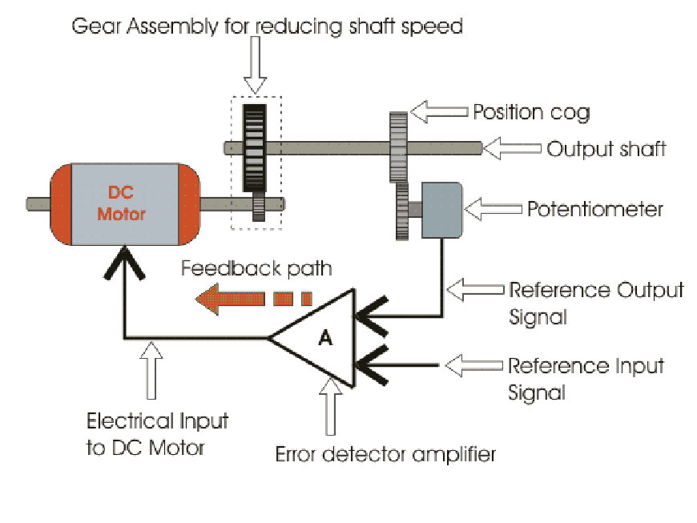

Slide 24
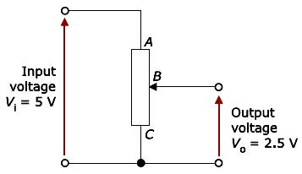

Slide 25
Suppose, we have given a signal to rotate servomotor by an angle of 45° and then stop and wait for further instruction.
The shaft of the DC motor is coupled with another shaft called output shaft, with help of gear assembly. This gear assembly is used to step down the high rpm of the motor's shaft to low rpm at output shaft of the servo system.
The voltage adjusting knob of a potentiometer is so arranged with the output shaft by means of another gear assembly, that during rotation of the shaft, the knob also rotates and creates an varying electrical potential. This signal i.e. electrical potential is increased with angular movement of potentiometer knob along with the system shaft from 0° to 45°. This electrical potential or voltage is taken to the error detector feedback amplifier along with the input reference commends i.e. input signal voltage.

Slide 26
As the angle of rotation of the shaft increases from 0° to 45° the voltage from potentiometer increases. At 45° this voltage reaches to a value which is equal to the given input command voltage to the system. As at this position of the shaft, there is no difference between the signal voltage coming from the potentiometer and reference input voltage(command signal) to the system, the output voltage of the amplifier becomes zero.
From Figure it can be observed that the output electrical voltage signal of the amplifier, acts as input voltage of the DC motor. Hence the motor will stop rotating after the shaft rotates by 45°. The motor will be at this rest position until another command is given to the system for further movement of the shaft in desired direction.

Slide 27
Applications of servo motors
Machine Tool (Metal Cutting)
Machine Tool (Metal forming)
Antenna Positioning •
Packaging
Woodworking
Textiles
Printing
Rope/Twine manufacturing
Floor polishing
Material Handling
Door Opening
Water spinning
Medical equipment

